Slide 1
HAIR AND SCALP DISEASE DETECTION
Presented by: Abhi Krishnan
Roll No.: MCA23-102
Guide: Prof. Nadera Beevi S
Date: 06/11/2024

Slide 2
INTRODUCTION
Hair diseases can negatively impact both physical appearance and health, yet traditional diagnosis methods are slow and often require a specialist.
This project creates an automated hair disease detection system utilizing deep learning models such as CNN, VGG16, and Mobilenet.
The models are trained on a diverse dataset of hair disease images to ensure accurate and reliable detection.
The objective is to offer users a fast, accessible solution for early detection and treatment, enhancing scalp health and overall well-being.

Slide 3
PROBLEM STATEMENT
Hair diseases are common yet often go unnoticed until they progress, causing discomfort, hair loss, and psychological distress.
Traditional diagnosis requires professional expertise, which can be costly and time-consuming, limiting timely access to treatment.
Many individuals lack awareness and resources for early detection and appropriate care, leading to untreated conditions.
This project addresses these issues by developing an automated hair disease detection tool that uses deep learning to provide quick, accurate diagnosis and treatment recommendations, enabling accessible and proactive hair health management.

Slide 4
Literature review
Title | Authors | Published Year | Publisher | Algorithm Used
Hair & Scalp Disease Detection Using Deep Learning & Image Processing | Er. Rajeshwari Suryawanshi, Aishwarya Wanjari, Megha Mahajan, Tanaya Kachewar, Vedanti Khobragade | April 2024 | Journal of Emerging Technologies and Innovative Research (JETIR), Volume 11, Issue 4 | VGG architecture with transfer learning (CNN)
Hair and Scalp Disease Detection Using Machine Learning and Image Processing | Mrinmoy Roy, Anica Tasnim Protity | January 2023 | European Journal of Information Technologies and Computer Science, Vol 3, Issue 1 | 2D Convolutional Neural Network (CNN)

Slide 5
Gap Identification(Existing System)
Limited Accuracy: struggle to accurately diagnose hair diseases due to subjective interpretation and variability in visual presentation.
Manual Effort: Often rely on human inspection, making the process time-consuming and error-prone.
No Real-Time Analysis: Many systems can’t provide instant results after uploading an image.

Slide 6
Proposed System
Accurate Detection: The deep learning model accurately identifies various hair diseases, improving diagnostic precision.
Real-Time Analysis: Users receive immediate feedback on uploaded images, facilitating prompt treatment recommendations.
Advanced Feature Extraction: The system employs sophisticated techniques to analyze hair and scalp conditions, ensuring reliable results.

Slide 7
Approach
Dataset Selection
Use the Hair Disease dataset from Kaggle for training
Model Selection
Used 3 models: Custom CNN, VGG, Mobilenet
Model Training
Trained the model using selected Dataset, implemented early stoppage to avoid overfitting
Evaluation
Evaluate the models using training and validation accuracy and loss to assess their performance during training.

Slide 8
Testing
Test the model with unseen data
Deployment
Develop a flask application to deploy the model
Documentation
The project is documented with all the steps, including dataset selection, model architecture, training, evaluation, testing, and deployment.

Slide 9
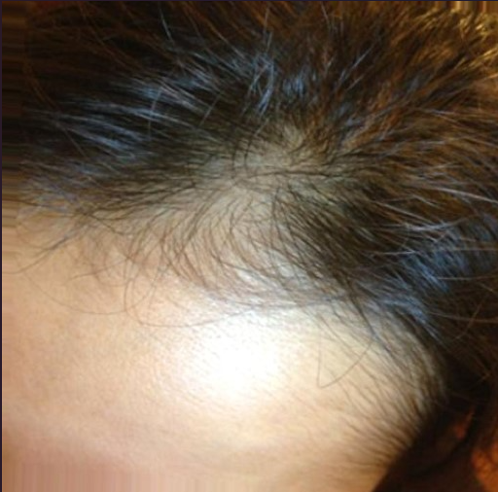
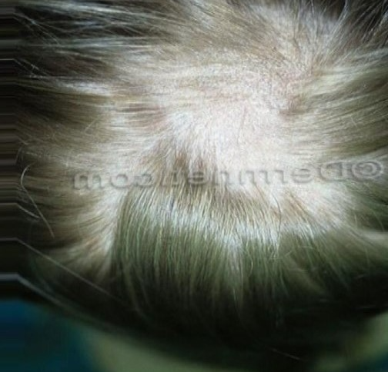
Dataset
Telogen Effluvium
Alopecia

Slide 10
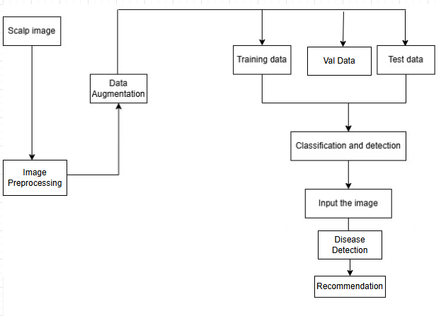
Block Diagram

Slide 11
Results
 | VGG | CNN | MOBILENET
Train Accuracy | 98.9% | 88.95% | 94.26%
Validation Accuracy | 97.67% | 99.33% | 99.25%
Test Accuracy | 99.5% | 99.25% | 98.92%

Slide 12
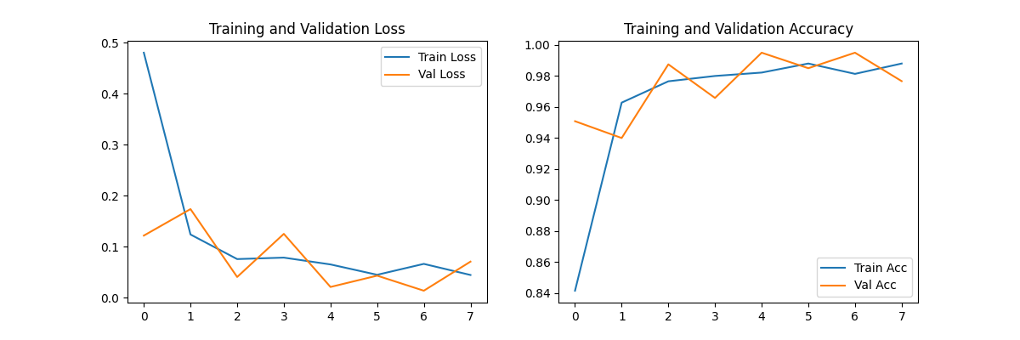
Results (VGG)

Slide 13
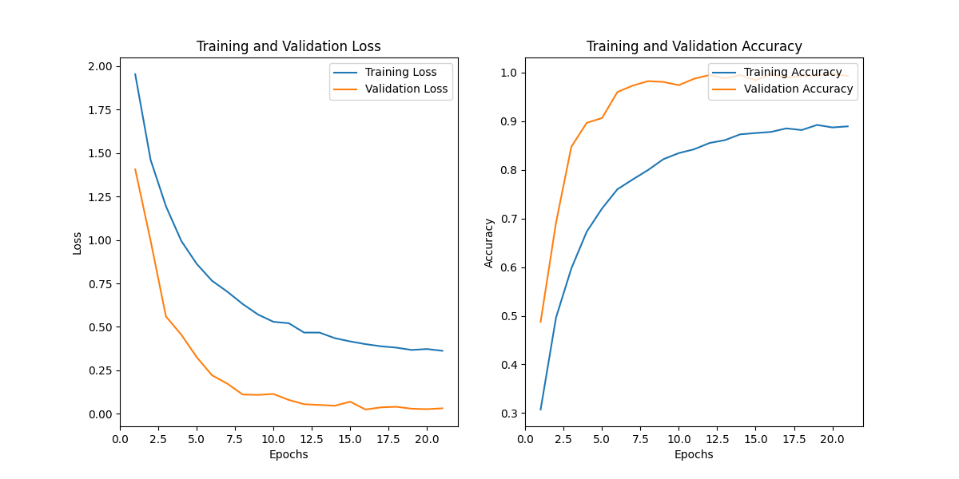
Results (CNN)

Slide 14
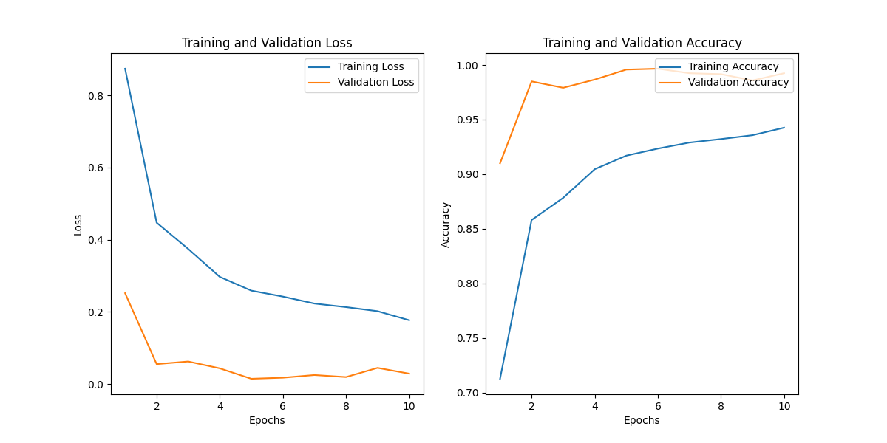
Results (MobileNet)

Slide 15
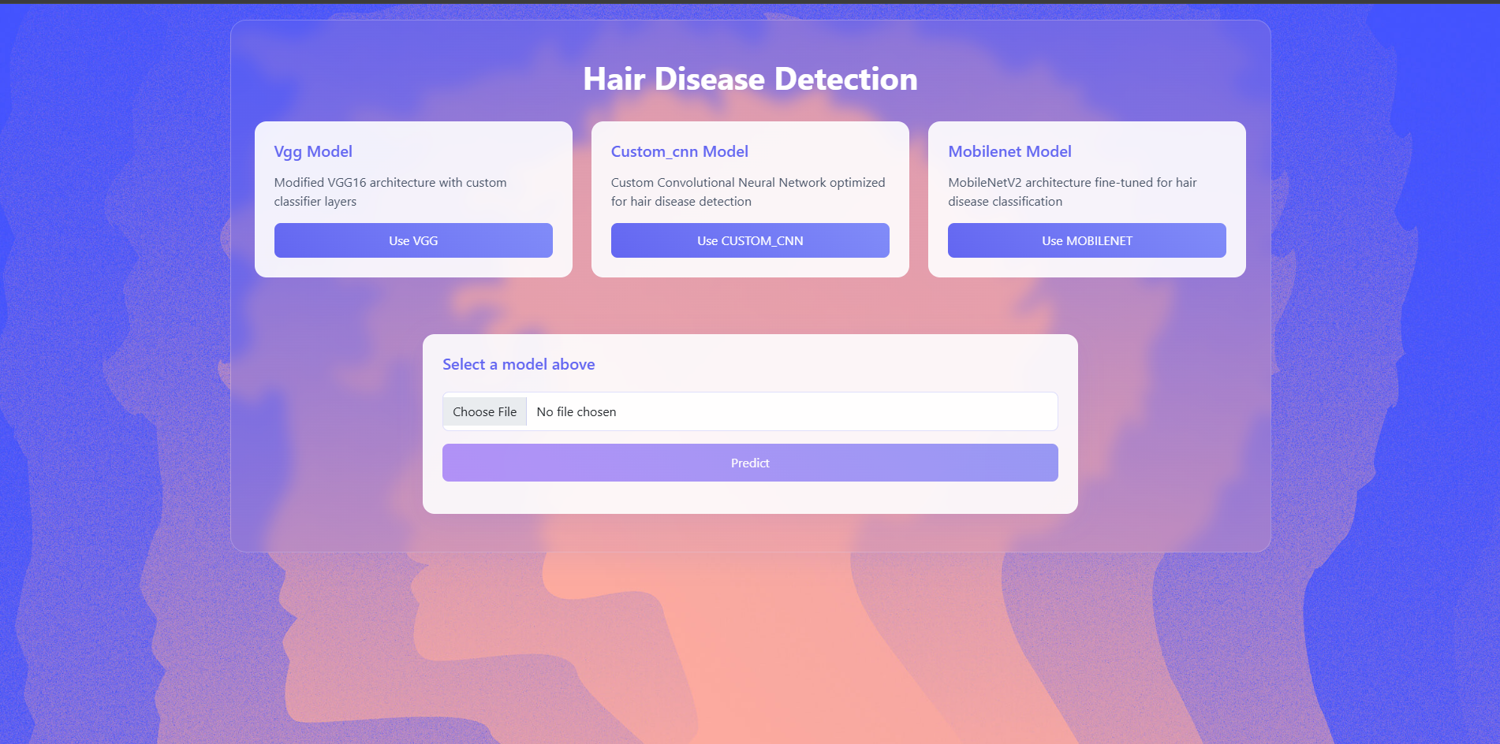
Screenshots

Slide 16
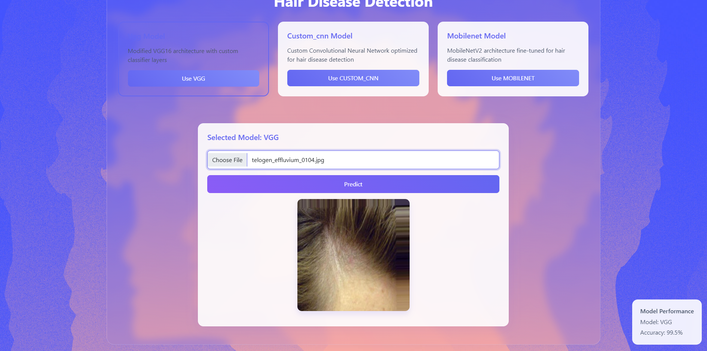

Slide 17
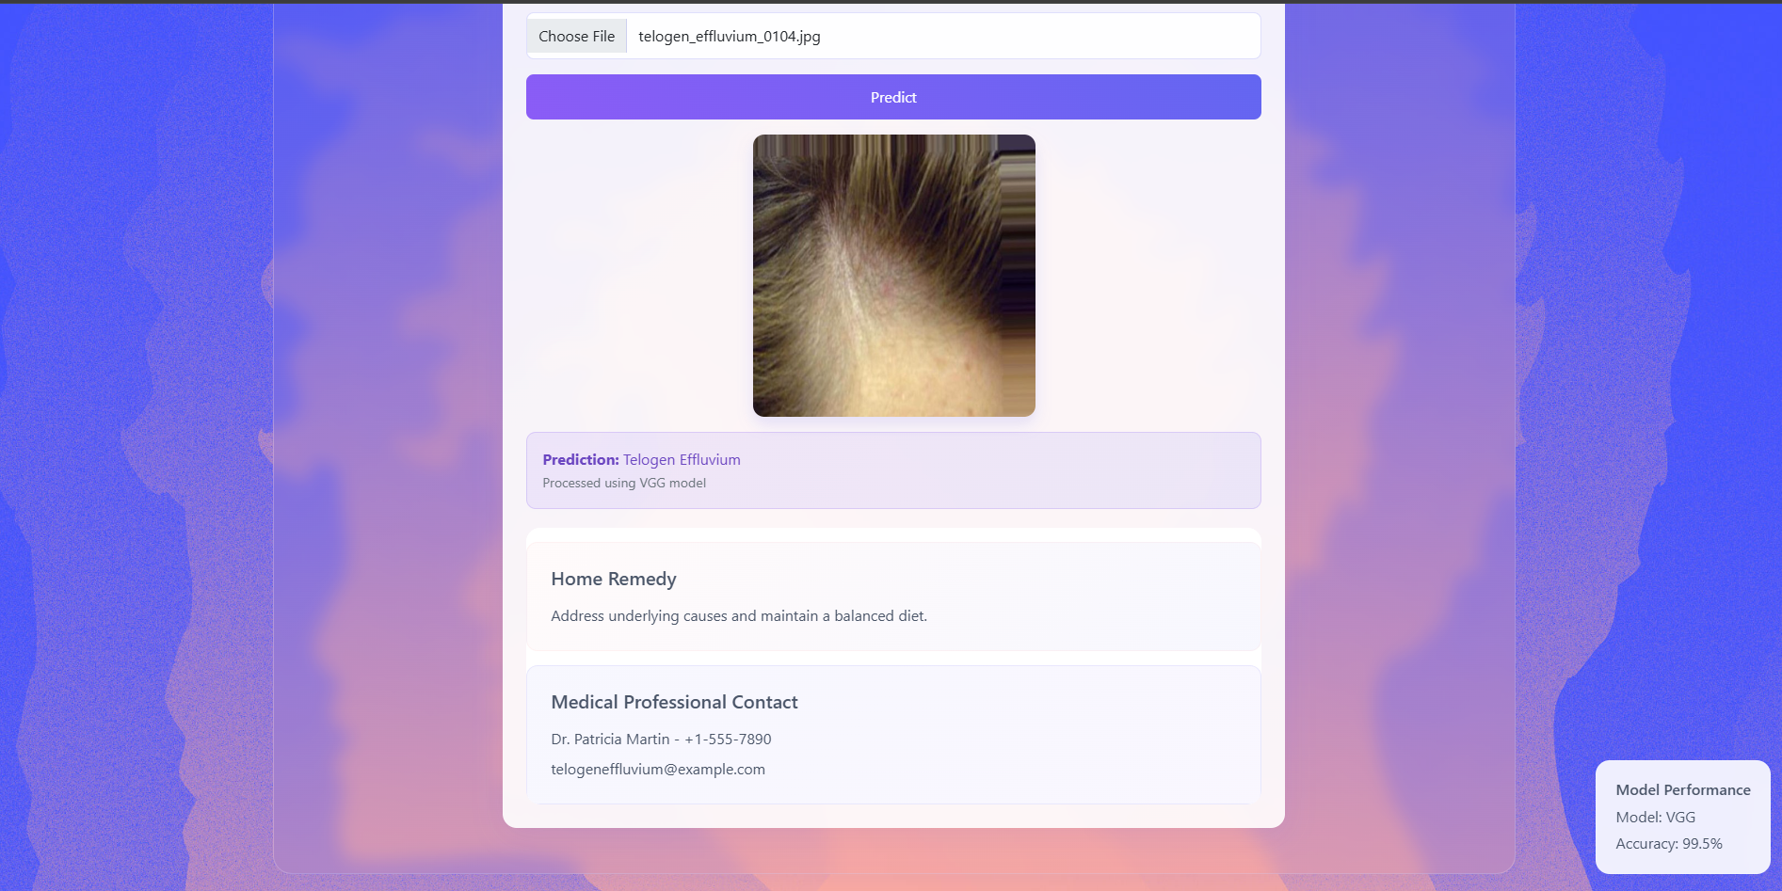

Slide 18
Future Enhancement
Mobile App: Develop a mobile application for users to upload images and get results instantly.
Healthy Hair Dataset: Add healthy scalp images to improve disease detection accuracy.
Hair Care Partnerships: Collaborate with hair care brands to recommend suitable products.
Personalized Suggestions: Offer customized care recommendations based on user profiles.

Slide 19
References
R. Suryawanshi, A. Wanjari, M. Mahajan, T. Kachewar, and V. Khobragade, “Hair & Scalp Disease Detection Using Deep Learning & Image Processing,” Journal of Emerging Technologies and Innovative Research, vol. 11, no. 4, pp. 512-516, Apr. 2024. [Online]. Available: https://www.jetir.org/papers/JETIR2404160.pdf
Ibrahim, S., Noor Azmy, Z. A., Abu Mangshor, N. N., Sabri, N., Ahmad Fadzil, A. F., Ahmad, Z. (2020). Pretrained classification of scalp conditions using image processing. Indonesian Journal of Electrical Engineering and Computer Science, 20(1), 138–144.

Slide 20
References
Sultanpure, K., Shirsath, B., Bhande, B., Sawai, H., Gawade, S., Samgir, S. (2024, March 9). Hair and scalp disease detection using deep learning. arXiv preprint arXiv:2403.07940.
Banerjee, D., Kukreja, V., Bordoloi, D., Choudhary, A. (2024, March 21). Enhanced hair disease classification using deep learning. In 2024 11th International Conference on Signal Processing and Integrated Networks (SPIN) (pp. 58-63). IEEE

Slide 21
THANK YOU

